Slide 1
DENOISING IMAGE USING DEEP CNN AUTOENCODER
PRESENTED BY
KEERTHANA K [513121104014]
THANTHAI PERIYAR GOVERNMENT INSTITUTE OF TECHNOLOGY , VELLORE.

Slide 2
AGENDA
Problem Statement
Project Overview
End users
Flow of the project 1.Understanding Autoencoders
2.Model Architecture Design
3.Image Generation
Usage of Deep CNN Autoencoder
Results
Conclusion

Slide 3
PROBLEM STATEMENT
The problem at hand involves denoising images using deep convolutional neural network (CNN) autoencoders. Image denoising is a critical task in various domains such as medical imaging, surveillance, and photography. Noisy images degrade the quality of visual information, making it challenging for downstream tasks like object recognition or image segmentation. Traditional denoising techniques often rely on handcrafted filters or statistical methods, which may not effectively capture complex noise patterns or preserve image details.

Slide 4
PROJECT OVERVIEW
OBJECTIVE :
The objective is to train a deep CNN autoencoder for image denoising, enhancing image quality across domains. Additionally, the project aims to advance deep learning methodologies and provide insights for computer vision applications.
SIGNIFICANCE:
Improved Visual Quality: Enhances image clarity and interpretability across domains through noise removal using deep CNN autoencoders.
Streamlined Workflow: Automation of denoising processes saves time and resources while ensuring consistent results in various image analysis tasks.
Advancing AI Methodologies: Contributes to the progression of deep learning techniques, benefiting fields beyond image denoising, such as computer vision and artificial intelligence.

Slide 5
END USERS
Medical Professionals: Radiologists and doctors can utilize denoising techniques to improve the clarity of medical images, aiding in accurate diagnosis and treatment planning.
Security Agencies: Surveillance firms can enhance the quality of surveillance footage through denoising, improving threat detection and monitoring capabilities.
Photographers and Graphic Designers: Professionals in creative industries can achieve higher-quality images by removing noise, enhancing visual appeal and marketability.
Environmental Researchers: Remote sensing specialists can utilize denoising methods to enhance satellite imagery, facilitating better analysis for environmental monitoring and urban planning.

Slide 6
FLOW OF THE PROJECT
1.Understanding Autoencoders
2.Model Architecture Design
3.Image Generation

Slide 7
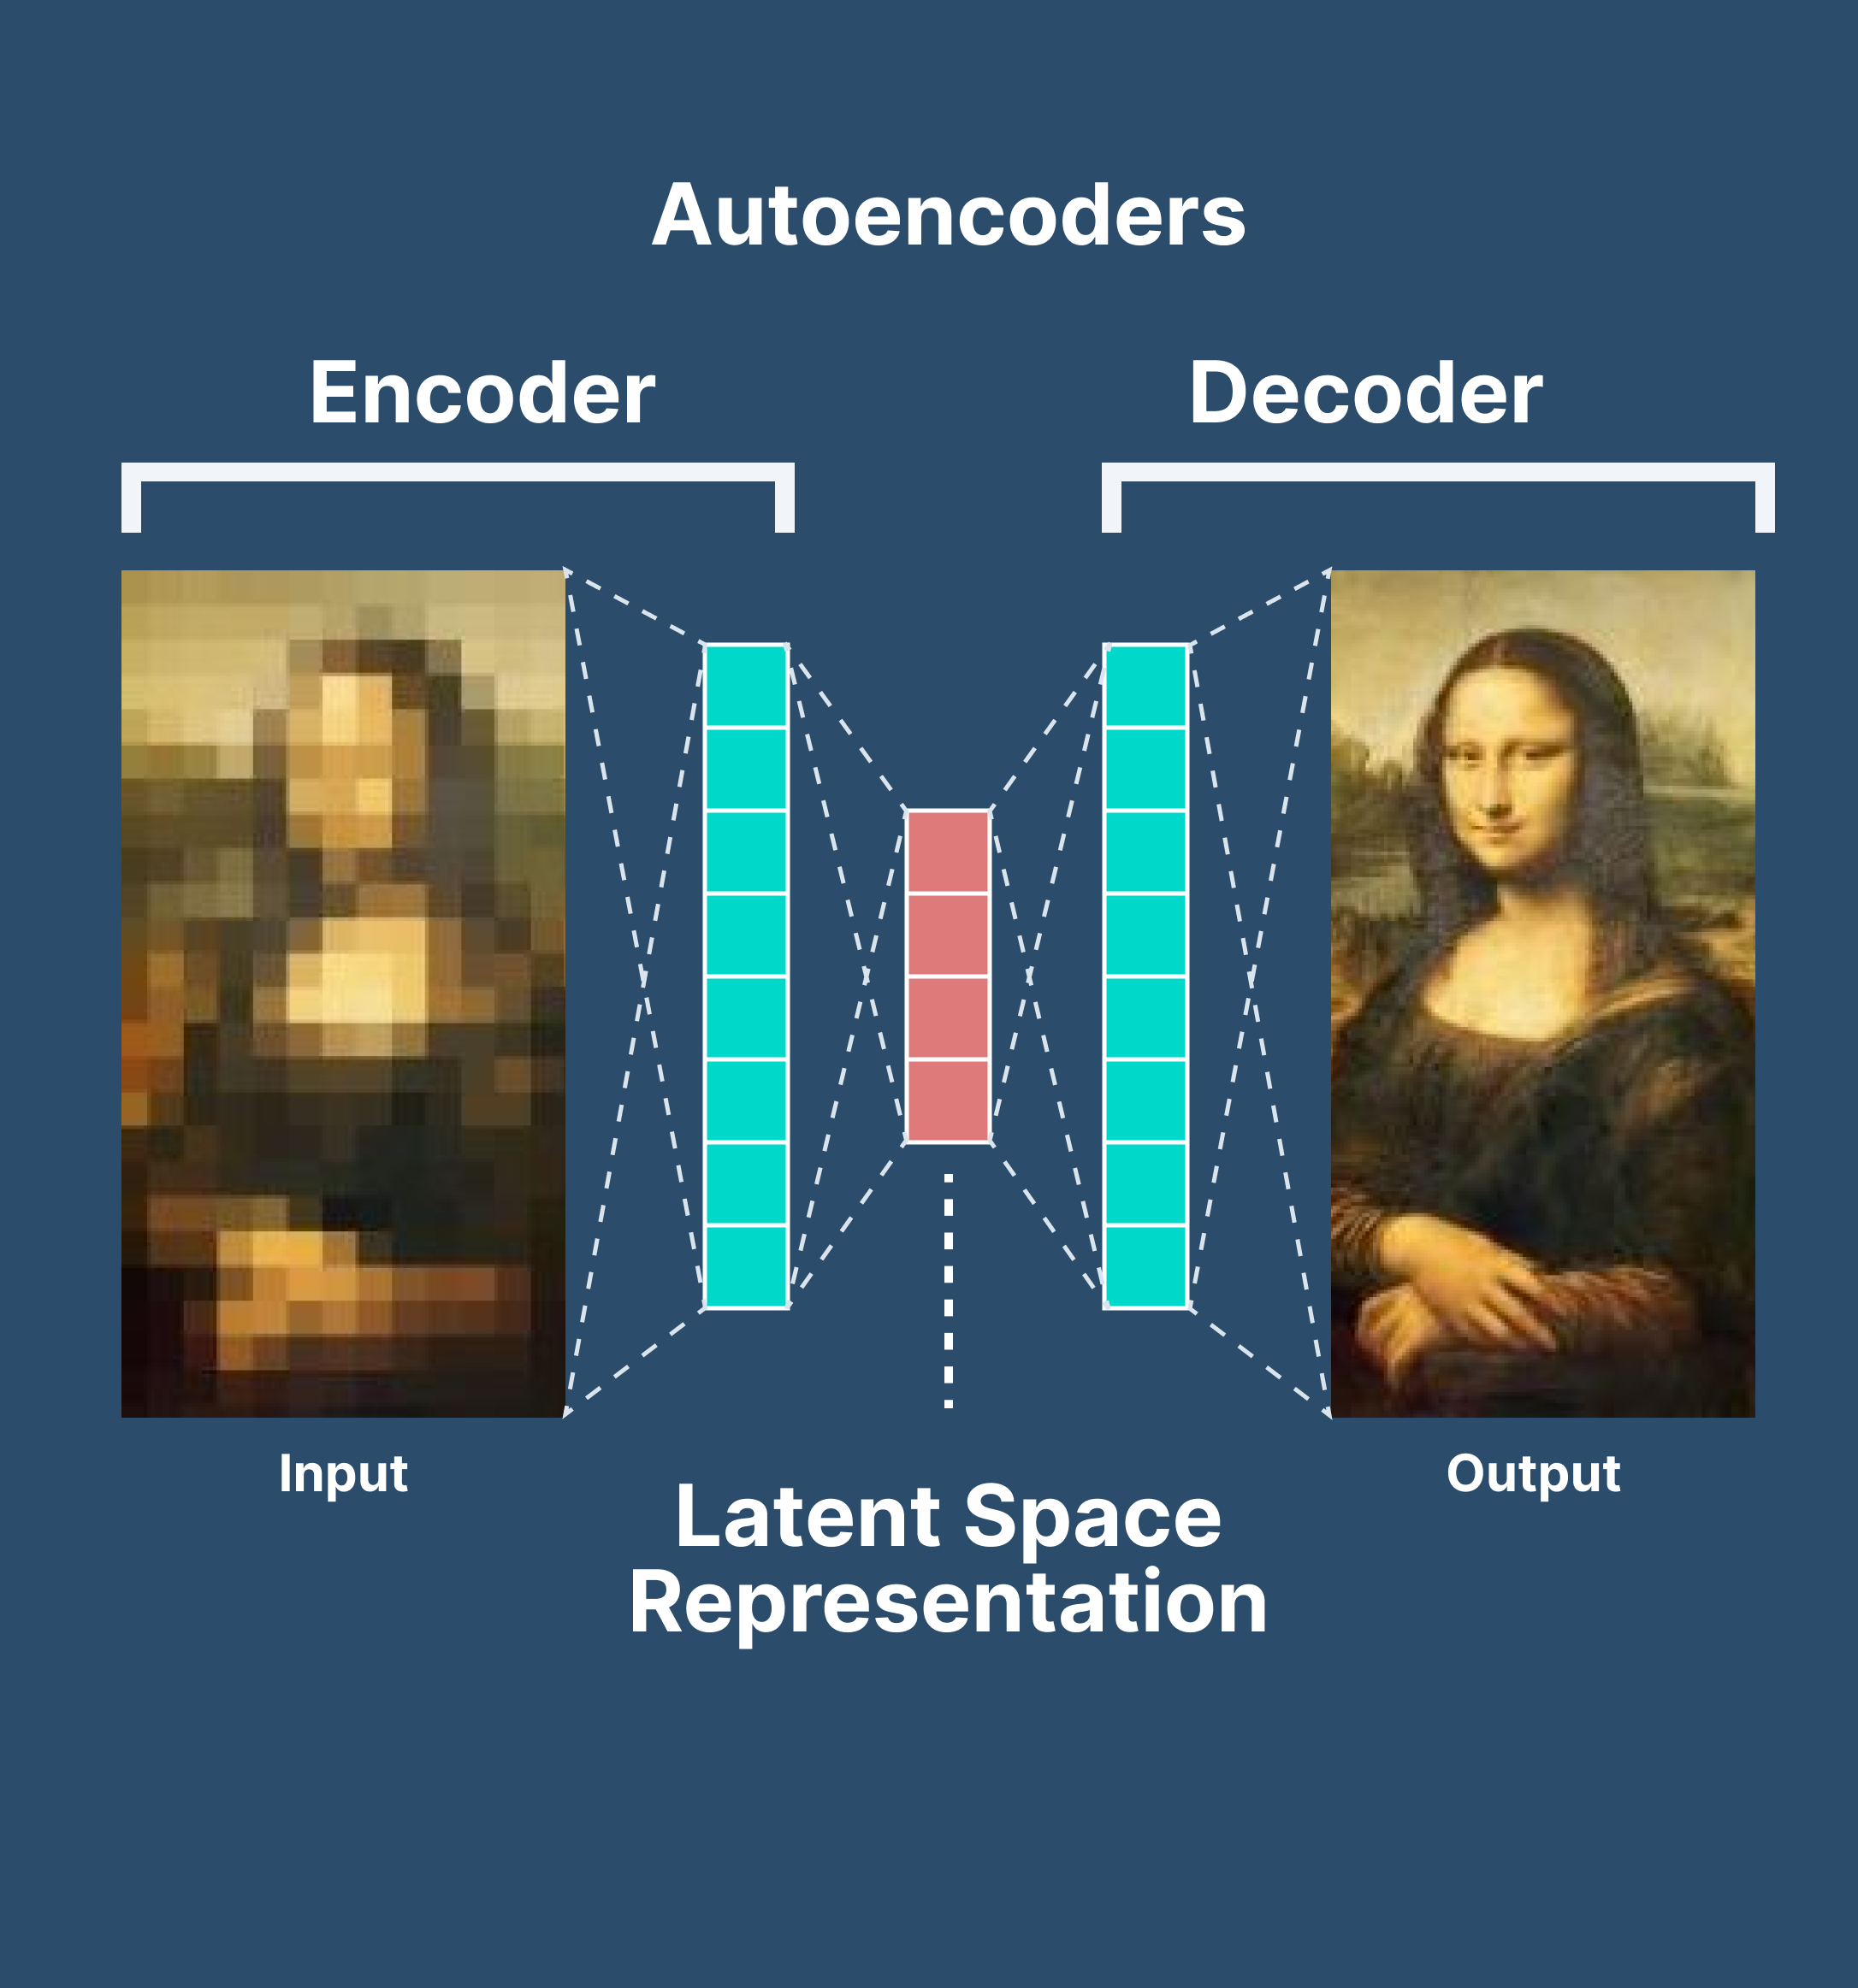
Understanding Autoencoders
In convolutional neural networks (CNNs), an autoencoder is a type of neural network architecture comprising an encoder and a decoder. The encoder compresses input images into a lower-dimensional representation, while the decoder reconstructs the original images from this representation. By minimizing the reconstruction error during training, typically using a loss function like mean squared error, autoencoders learn to extract meaningful features from the input data. In CNNs, autoencoders are particularly useful for tasks such as image reconstruction, denoising, and feature learning, leveraging the hierarchical feature extraction capabilities of CNNs to capture complex patterns in the data.

Slide 8
Model Architecture Design
Architecture Design: Configure the deep CNN autoencoder with encoder-decoder components to compress images and reconstruct them, optimizing feature extraction and preservation.
Training Process: Train the model with dataset splits, adjusting hyperparameters and applying regularization techniques to prevent overfitting and enhance denoising accuracy.
Loss Function and Evaluation: Utilize appropriate loss functions during training and evaluate performance using metrics like PSNR and MSE, ensuring effective noise reduction and image quality preservation.

Slide 9
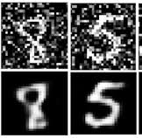
Image Generation
Architecture Design: Develop an autoencoder with a decoder component capable of generating images by learning to reconstruct input data from a compressed latent space representation.
Training Process: Train the autoencoder using a dataset of images, optimizing the model parameters to accurately reconstruct input images and capture meaningful features in the latent space.
Latent Space Exploration: Generate new images by sampling random points from the learned latent space and decoding them using the trained decoder, allowing for the creation of novel and diverse image samples.

Slide 10
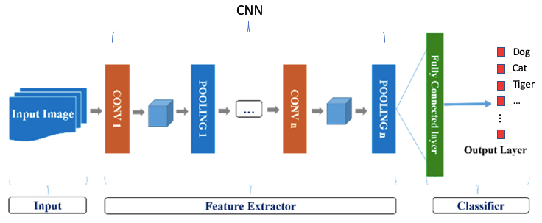
Usage of Deep CNN Autoencoder
Image Denoising: Deep CNN autoencoders remove noise from images by training to reconstruct clean versions from noisy inputs, enhancing image quality for medical imaging, surveillance, and photography.
Feature Extraction: They learn meaningful representations from unlabeled data, aiding in feature extraction for tasks like classification, clustering, and anomaly detection without explicit supervision.
Image Generation: By sampling from the learned latent space, deep CNN autoencoders generate diverse and novel images, useful for creative applications, data augmentation, and image synthesis.

Slide 11
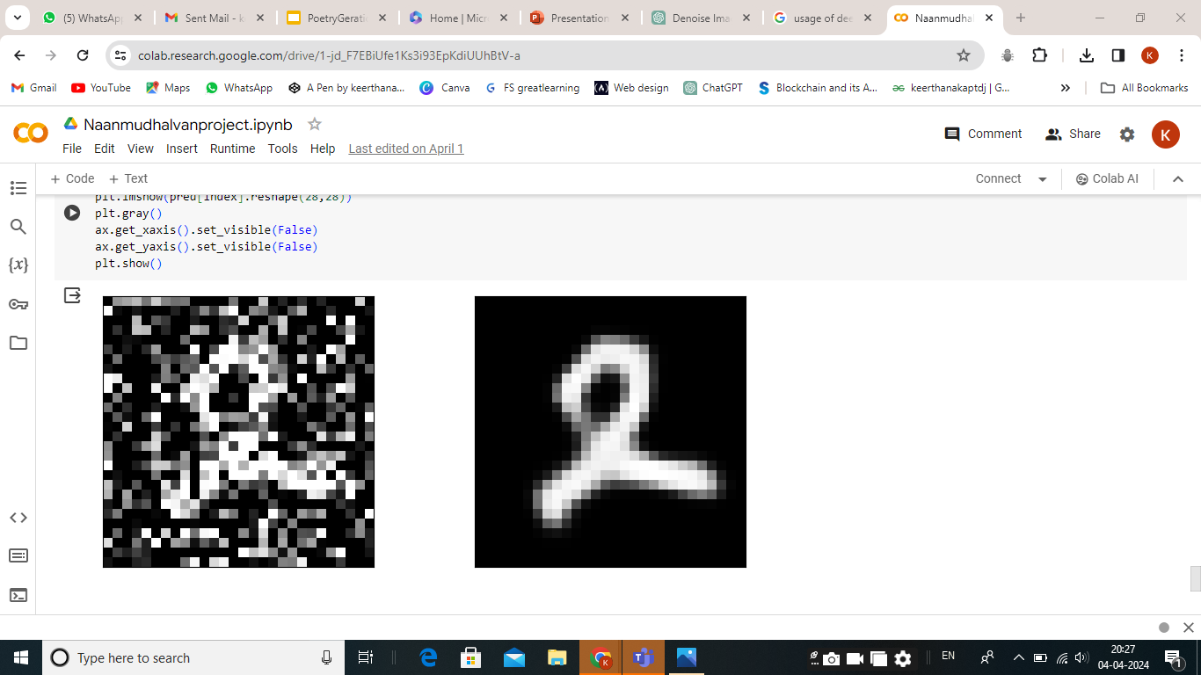
RESULTs
COLAB NOTEBOOK: https://colab.research.google.com/drive/1-jd_F7EBiUfe1Ks3i93EpKdiUUhBtV-a

Slide 12
CONCLUSION
In conclusion, the project focused on developing a deep convolutional neural network (CNN) autoencoder for image denoising, aiming to enhance image quality across various domains. Through careful architecture design, training process optimization, and exploration of the latent space, the autoencoder demonstrated effective noise reduction capabilities and the generation of novel images. By leveraging deep CNN autoencoders, applications such as image denoising, feature learning, and image generation can benefit from improved accuracy, efficiency, and versatility. Moving forward, further research and experimentation with advanced techniques and real-world applications can continue to push the boundaries of deep learning methodologies for image processing tasks.

Slide 13
REFERENCES:
https://keras.io/
https://www.tensorflow.org/
https://numpy.org/
https://en.wikipedia.org/wiki/Autoencoder
https://ieeexplore.ieee.org/document/9760333

